Slide 1
Foundations in Linked Data
for Serialists
June 8, 2018
NASIG
Amber Billey (abilley@bard.edu)
Bard College Libraries
Robert Rendall (rr2205@columbia.edu)
Columbia University Libraries

Slide 2
Agenda and Learning Outcomes
Linked Data 101 (Robert)
Ontology Basics (Amber)
Turtle Tutorial (Amber)
Serials RDA Elements in BIBFRAME (Robert)
Hands-on lab time!
https://github.com/amberbilley/NASIG18_LDworkshop

Slide 3
Linked Data 101

Slide 4
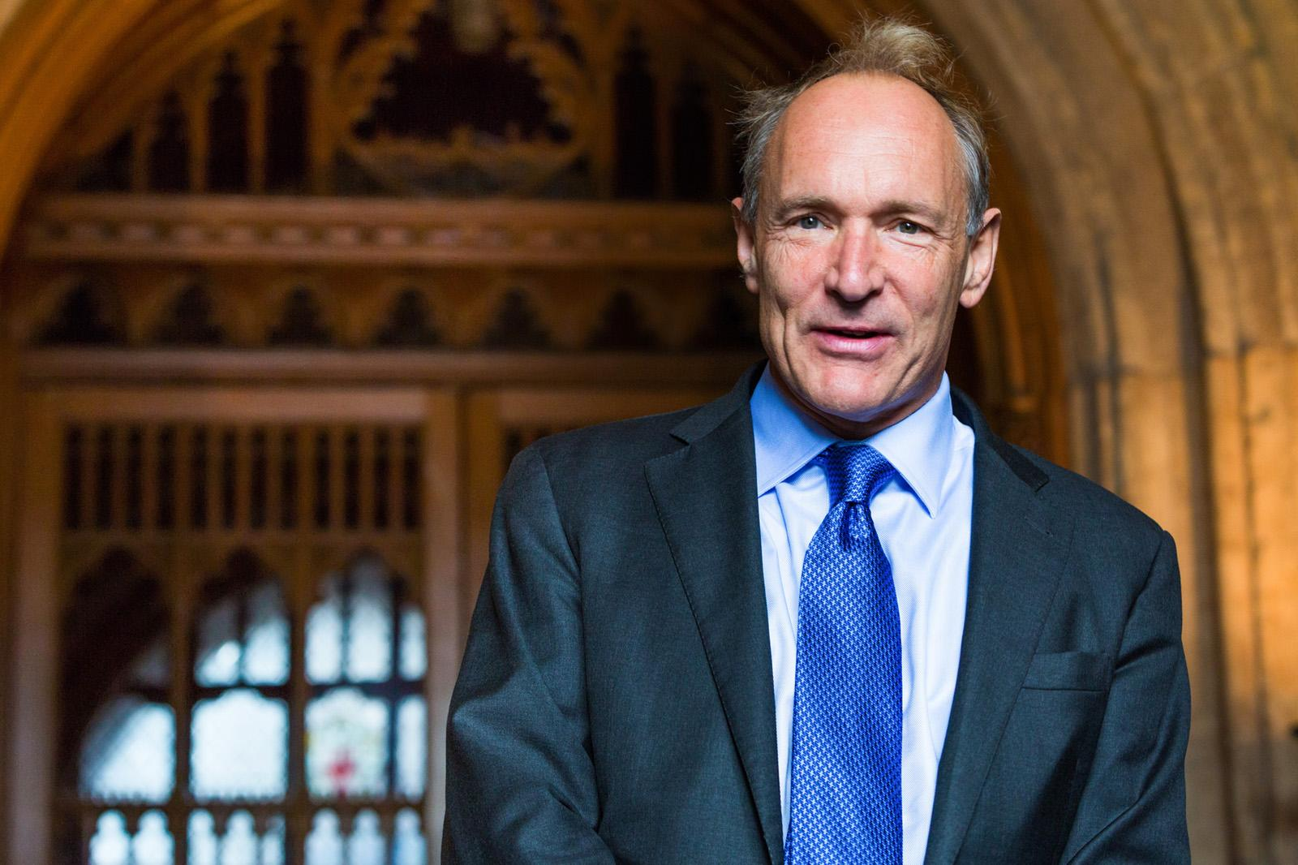
“The Semantic Web isn't just about putting data on the web. It is about making links, so that a person or machine can explore the web of data. With linked data, when you have some of it, you can find other, related, data.”
https://www.w3.org/DesignIssues/LinkedData.html
Tim Berners-Lee, 2006
Notes:
“Inventor” of the World Wide Web 1989
Director of the World Wide Web Consortium (Web standards organization) since he founded it in 1994.
Coined the term “Semantic Web” in 1998 (the “next generation” of the Web, integrating data from diverse sources and recording how it relates to real world objects)
Coined the term “Linked Data” in 2006 (best practices for publishing and connecting structured data on the Web)

Slide 5
Rules of Linked Data
Use URIs as names for things
Use HTTP URIs so that people can look up those names.
When someone looks up a URI, provide useful information.
Include links to other URIs so that they can discover more things.
https://www.w3.org/DesignIssues/LinkedData.html
Notes:
Also called principles. Some sources give the third rule as: When someone looks up a URI, provide useful information, using the standards (RDF, SPARQL)
1. URI: standard identifier
2. HTTP: protocol for looking up URIs
3. give more information (that people will be able to use)
4. link to other URIs

Slide 6
5-Star Linked Open Data
★
Available on the web (whatever format) but with an open licence, to be Open Data
★★
Available as machine-readable structured data (e.g. excel instead of image scan of a table)
★★★
as (2) plus non-proprietary format (e.g. CSV instead of excel)
★★★★
All the above plus, Use open standards from W3C (RDF and SPARQL) to identify things, so that people can point at your stuff
★★★★★
All the above, plus: Link your data to other people’s data to provide context
https://www.w3.org/DesignIssues/LinkedData.html
Notes:
Not all linked data is open. But these are Berners-Lee’s standards for linked open data.
1. Make your data available to anyone without restrictions
2. Make it possible to process or export the data
3. Without requiring people to buy things to do so
4. Enable others to link to your data
and you get five stars if you
5. Make your data more valuable by putting it in context

Slide 7
The Linked Data Technology Stack
URI (Uniform Resource Identifier)
HTTP (HyperText Transfer Protocol)
http://id.loc.gov/vocabulary/issuance/serl
Notes:
URI: a string of characters used to identify a resource
HTTP: a means to structure and link documents on the Web. HTTP URIs can be “looked up” on the Web. These are the URIs we’ll be working with.
This is the HTTP URI for LC’s mode of issuance term “serial.”
scheme:host/path

Slide 8
The Linked Data Technology Stack
RDF (Resource Description Framework)
<http://bibframe.example.org/instance/instanceY> <http://bibframe.org/vocab/instanceOf> <http://bibframe.example.org/work/workX> .
Notes:
RDF: a data model/framework to structure and link data
Using the RDF model, you can make this statement about a FRBR relationship (instanceY is an instance of workX) using a subject, predicate and object.

Slide 9
The Linked Data Technology Stack
RDFS (RDF Vocabulary Definition Language)
OWL (Web Ontology Language)
<owl:DatatypeProperty rdf:about="http://id.loc.gov/ontologies/bibframe/firstIssue">
<rdfs:range rdf:resource="http://www.w3.org/2000/01/rdf-schema#Literal"/>
<skos:definition>
Beginning date of a resource and/or the sequential designations.
</skos:definition>
<rdfs:comment>Used with Work or Instance</rdfs:comment>
<rdfs:label>Multipart first issue</rdfs:label>
<dcterms:modified>2016-04-21 (New)
</dcterms:modified>
</owl:DatatypeProperty>
Notes:
RDFS/OWL: languages used to define vocabularies as ontologies (OWL is more complex than RDFS)
Here OWL, RDFS and other standards are being used to define the BIBFRAME property “bf:firstIssue”: what it means, how it can be used, when it was last modified.

Slide 10
The Linked Data Technology Stack
SPARQL (SPARQL Protocol and RDF Query Language)
PREFIX bf: <http://bibframe.org/vocab/>
SELECT ?title
FROM <http://loc.gov/catalog/dataset.rdf>
WHERE {
?x bf:title ?title .
}
ORDER BY ?title
Notes:
A “recursive acronym”
SPARQL: A protocol/query language to retrieve and manipulate data stored in RDF
This is a request to find all the titles (which are objects of the property bf:title) in dataset.rdf and return them as an alphabetical list.

Slide 11
Who Is Using Linked Data?
Search engines (schema.org)
Wikipedia (DBPedia and Wikidata)
Europe
GeoNames
http://lod-cloud.net/
Notes:
Schema.org is a vocabulary for structured data on webpages that search engines can use.
DBPedia is a project to publish structured data from Wikipedia; Wikidata is a knowledge base of structured data from all Wikimedia sites.
The European Union has an open data portal, and there are similar projects in individual European countries.
GeoNames (a database of geographic information from public sources - including BGN and GNIS) has published its data as linked data.
The LOD cloud diagram image shows datasets that have been published in Linked Data format, by contributors to the Linking Open Data community project and other individuals and organisations.
You can see the growth of linked data by looking at older versions listed at http://lod-cloud.net/versions/.

Slide 12
Ontology Basics

Slide 13
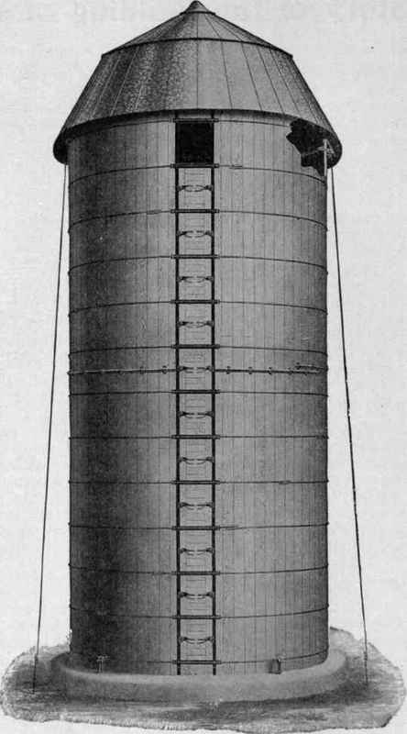

Moving from MARC silos to the WWW
MARC

Slide 14
Differences between MARC and LD tech stacks
MARC
MARC (syntax)
ILS (data storage and delivery)
SQL Database
Z39.50 (query and transmission)
Discovery Layer (data delivery)
LINKED DATA
RDF (data model)
XML, JSONLD, N3, Turtle, … (syntax)
Triplestore (data storage)
SPARQL (query)
WWW (data delivery)

Slide 15
What exactly is BIBFRAME?
BIBFRAME is a LD vocabulary
Being formally encoded for machine processing using W3C standards such as OWL or RDFS makes it an ontology
BIBFRAME is heavily inspired by MARC to prevent loss of legacy data
BIBFRAME is intended to accommodate FRBR and RDA, but is structure and content standard agnostic for an evolving standards landscape

Slide 16
Primary Descriptive Cataloging Model and Their Standards
Structure Standard
ISBD, MARC, FRBR, Dublin Core, EAD, MODS, VRACore, CIDOC, BIBFRAME
Content Standard
AACR2, RDA, CCO, DACS, ...
Value Standard
LCSH, NAF, LCGFT, RDA Vocabularies, RBMS Thesauri, AAT, …
Encoding Standard
3x5 card, MARC (ISO 2709), CVS, XML, RDF-XML, JSON, Turtle ...
Notes:
This slide puts BIBFRAME into perspective with common library cataloging models. MARC was both an encoding and structure standard, and therefore it’s not particularly flexible in today’s web environment. BIBFRAME is just a new structure standard, with defined classes and properties that have URIs and fits into a new model for describing bibliographic information. Actually BIBFRAME will enable full RDA descriptions with it’s Work to Instance relationships.

Slide 17

Cherry Pick Vocabularies. Build Custom Ontologies.
Build 5-star linked data
Linked data allows for customization
So BF can be one of several ontologies that we use for bibliographic descriptions
Be careful!
https://lov.okfn.org/dataset/lov/

Slide 18
RDF
The Structure Standard for Linked Data

Slide 19
Resource Description FrameWork
Conceptual model for structuring data and relationships
It is a W3C Standard framework for data interchange on the Web
Enables the creation of relationships between things on the Web

Slide 20
The RDF TRIPLE
Subject
Object
predicate
Virginia Library Association
Virginia Libraries
publisher
http://id.loc.gov/authorities/names/n80023576
https://ejournals.lib.vt.edu/valib/index
http://purl.org/dc/terms/publisher

Slide 21
RDF Triple in XML
<?xml version="1.0"?>
<!DOCTYPE rdf:RDF PUBLIC "-//DUBLIN CORE//DCMES DTD 2002/07/31//EN"
"http://dublincore.org/documents/2002/07/31/dcmes-xml/dcmes-xml-dtd.dtd">
<rdf:RDF xmlns:rdf="http://www.w3.org/1999/02/22-rdf-syntax-ns#"
xmlns:dc="http://purl.org/dc/elements/1.1/">
<rdf:Description rdf:about="https://ejournals.lib.vt.edu/valib/index">
<dc:title>Virginia Libraries</dc:title>
<dc:publisher rdf:resource="http://id.loc.gov/authorities/names/n80023576">Virginia Library Association</dc:publisher>
<dc:identifier>ISSN 1086-9751</dc:identifier>
</rdf:Description>
</rdf:RDF>

Slide 22
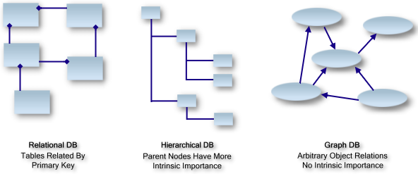
Image source: http://www.linkeddatatools.com/introducing-rdf/
Notes:
Libraries are used to working in Relationship Databases (think OPACS) and Hierarchical databases (think thesauri), but we’re not so familiar with Graph Databases. Graph databases have arbitrary object relationships with no intrinsic importance with the relationships between the objects or nodes.
For more about Graph Databases read this wikipedia page:
https://en.wikipedia.org/wiki/Graph_database

Slide 23
RDF Triple - another example
Subject
Object
Predicate
Paul Otlet
Traité de documentation
is CreatorOf
http://id.loc.gov/authorities/names/n90646362
http://purl.org/dc/elements/1.1/creator
http://www.worldcat.org/oclc/2294082
Notes:
Another simple RDF Triple example.

Slide 24
Linked Data expresses relationships!
Traité de Documentation
The five laws of library science
subject
subject
created
created
Library science
Ranganathan, S. R. (Shiyali Ramamrita), 1892-1972
Otlet, Paul, 1868-1944
Notes:
Let’s use some simple bibliographic information as an example. Here we see that Paul Otlet created the Traite de Documentation, and S.R. Ranganathan created The Five Laws of Library Science. Each of these works is about “Library science.” As librarians, we are familiar with this structure. We are used to adding name and subject authorities in our records.

Slide 25
Linked Data expresses relationships for machine processing.
http://www.worldcat.org/oclc/2294082
http://www.worldcat.org/oclc/18730828
http://purl.org/dc/elements/1.1/creator
http://purl.org/dc/elements/1.1/subject
http://purl.org/dc/elements/1.1/subject
http://purl.org/dc/elements/1.1/creator
http://id.loc.gov/authorities/subjects/sh85076723
http://id.loc.gov/authorities/names/n50053919
http://id.loc.gov/authorities/names/n90646362
Notes:
But linked data takes it a step further by encoding those relationships through stable hyperlinks - known as Uniform Resource Identifiers or URIs.

Slide 26
Linked Data is all about more relationships!
Traité de Documentation
The five laws of library science
subject
created
created
subject
Otlet, Paul, 1868-1944
Library Science
Ranganathan, S. R. (Shiyali Ramamrita), 1892-1972
lifespan:1898-1944
Twentieth Century
lifespan:1892-1972
birthplace:Brussels (Belgium)
birthplace:Sīrkāzhi (India)
occupation:Author
occupation:Librarian
flieldOfActivity:Pacifists
flieldOfActivity:Mathematics
gender:male
Men
gender:male
Notes:
And Linked Data can go even further by linking to additional contextual information. The possibilities for potential relationships are practically endless.

Slide 27
Linked Data links all the relationships!
Traité de Documentation
The five laws of library science
http://purl.org/dc/elements/1.1/creator
http://purl.org/dc/elements/1.1/subject
http://purl.org/dc/elements/1.1/creator
http://purl.org/dc/elements/1.1/subject
subject
created
subject
created
Otlet, Paul, 1868-1944
Library Science
Ranganathan, S. R. (Shiyali Ramamrita), 1892-1972
http://id.loc.gov/authorities/names/n90646362
http://id.worldcat.org/fast/997916
http://id.loc.gov/authorities/names/n50053919
lifespan:1898-1944
Twentieth Century
lifespan:1892-1972
http://id.worldcat.org/fast/1159810
http://id.loc.gov/authorities/names/n80072712
birthplace:Brussels (Belgium)
birthplace:Sīrkāzhi (India)
http://id.loc.gov/authorities/names/n79013830
occupation:Author
occupation:Librarian
http://id.worldcat.org/fast/821688
http://id.worldcat.org/fast/997301
flieldOfActivity:Pacifists
flieldOfActivity:Mathematics
http://id.worldcat.org/fast/1050133
http://id.worldcat.org/fast/1012163
gender:male
http://id.worldcat.org/fast/1015978
gender:male
Men
http://rdaregistry.info/termList/gender/1002
http://rdaregistry.info/termList/gender/1002
Notes:
In the example we see here: practically every element could be described with a Unique Resource Identifier, and therefore we can leverage linked data technology to encode the relationships and utilize external metadata.

Slide 28
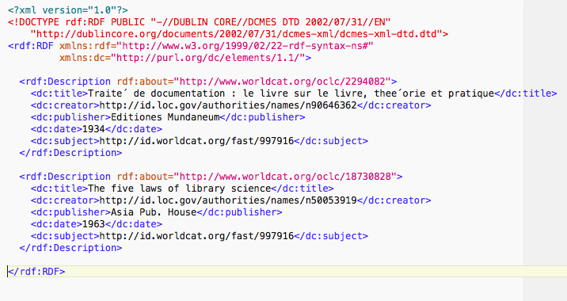
RDF Triple in XML

Slide 29
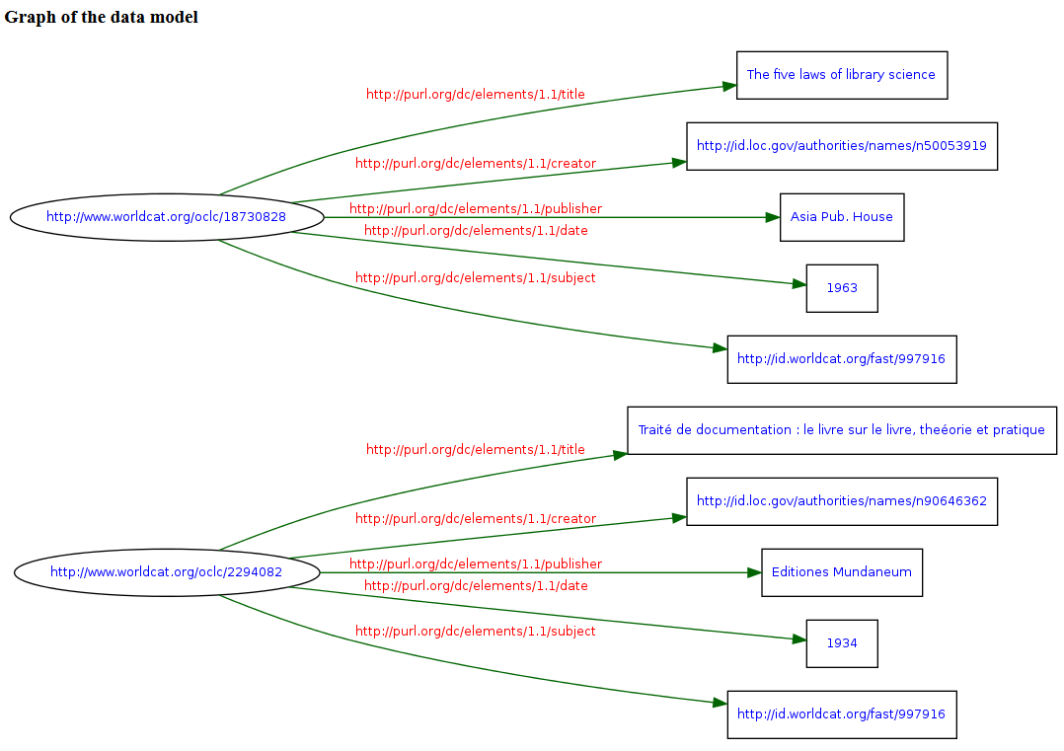
Notes:
Here is a visualization of that RDF/XML record in a graph. I used the RDF Validator to create this graph.
Using the RDF Validator: http://www.w3.org/RDF/Validator/

Slide 30
Linked Data Lexicon

Slide 31
De-Referencing URIs
“Dereferencing means you can get a lookup on the Web for the description of the reference concept resource.”*
http://id.loc.gov/ontologies/bibframe/Work.rdf
NOT http://id.loc.gov/ontologies/bibframe.html#c_Work
Utilizes the http protocol and RDF data to provide meaningful information when a URI is looked up by a machine. Puts the link in linked data!
*http://umbel.org/web-services/uri-dereferencing/

Slide 32
Class
A kind of thing.
Subjects and Objects belong to Classes.
You will usually see classes with the first letter in Uppercase.
bf:Work
bf:Instance
bf:Item
bf:Identifier
BIBFRAME CLASSES!

Slide 33
Sub-Class
A kind of thing that is a “sub-type” of a kind of thing.
Chihuahua is a kind of Dog.
ISBN is a kind of Identifier.
bf:Isbn
http://id.loc.gov/ontologies/bibframe.html#c_Identifier

Slide 34
Property
The relationships between Classes (or things/objects).
The “predicate.”
Usually listed with lower-case.
bf:title
bf:identifiedBy
bf:date

Slide 35
Sub-Property
A sub-type of a property.
bf:date
bf:originDate
bf:copyrightDate
bf:creationDate
http://id.loc.gov/ontologies/bibframe.html#p_date

Slide 36
Domain
The domain tells us what individuals (of a given class) this property is allowed to be applied to. AKA “Used with”
Concerns the Subjects of a predicate.
bf:Work
bf:Instance
bf:Item

Slide 37
Range
Range indicates the range of valid values this property can hold. AKA “Expected value”
Concerns the Objects of a predicate.
Literals
Objects/Individuals/URIs

Slide 38
Datatype Property
A property that can only relate to data and literals.
rdfs:label “The Organization of Information” .
rdfs:label “The Joy of Cataloging” .
rdf:label “123 pages.” .
bf:date "2007/2010"^^<http://id.loc.gov/datatypes/edtf> ;

Slide 39
Object type property
A property that can only relate to objects (URI things).
<http://example.com/Work_1> bf:contributor
<http://id.loc.gov/authorities/names/n80107118>

Slide 40
Individual
Something with a URI or an IRI. A thing. A resource. A subject or an object.
AKA: Named Individual
<http://example.com/Work_1> bf:contributor
<http://id.loc.gov/authorities/names/n80107118>

Slide 41
Blank Nodes
Ugh. blank nodes.
“a blank node (also called bnode) is a node in an RDF graph representing a resource for which a URI or literal is not given.^{[1]} The resource represented by a blank node is also called an anonymous resource. According to the RDF standard a blank node can only be used as subject or object of an RDF triple.”
Think of it as an alternative to link out to a URI as the object of a property.
https://en.wikipedia.org/wiki/Blank_node
Notes:
A blank node is an alternative to linking out to a URI as the object of an object property.
When no URI is available or appropriate, a blank node allows you to group together a package of information about something on the fly as you are creating data.
You specify the "type" (rdf:type, abbreviated as a) of the blank node to say what it represents (what sort of entity you would be linking out to, if you could: a title, a note, an agent, etc.).
The blank node then serves as the subject of other triples that contain the rest of the information in the package.

Slide 42
Open World Assumption
“In a formal system of logic used for knowledge representation, the open-world assumption is the assumption that the truth value of a statement may be true irrespective of whether or not it is known to be true. It is the opposite of the closed-world assumption, which holds that any statement that is true is also known to be true.”
(wikipedia)

Slide 43
Assertion
Saying something about a thing and expecting it to be true.
“In computer programming, an assertion is a statement that a predicate … is expected to always be true at that point in the code.” (wikipedia)

Slide 44
Inference
“Inference is the process of deriving logical conclusions from a set of starting assumptions. Using Linked Data, existing relationships are modeled as a set of (named) relationships between resources. Linked Data helps humans and machines to find new relationships through automatic procedures that generate new relationships based on the data and based on some additional information in the form of a vocabulary.”
https://www.w3.org/TR/ld-glossary/#inference

Slide 45
Entailment
“In pragmatics (linguistics), entailment is the relationship between two sentences where the truth of one (A) requires the truth of the other (B).”
(wikipedia)
SKOS:Concept and LCNAF example.

Slide 46
Are there other terms that are new to you?

Slide 47
Protege Demo

Slide 48

Protege
Software for ontology modeling and development.
http://protege.stanford.edu/
https://webprotege.stanford.edu/

Slide 49
Explore BIBFRAME Ontology
Open Protege
Click File > Open from URL
Enter the BIBFRAME ontology URL
http://id.loc.gov/ontologies/bibframe.rdf

Slide 50
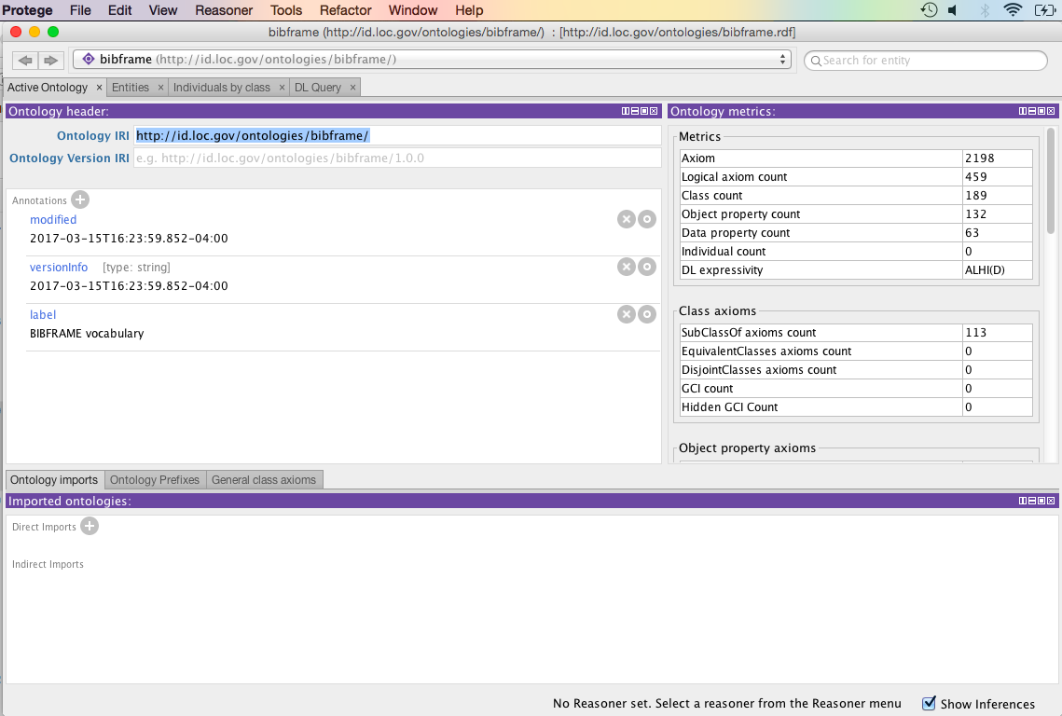

Slide 51
RDF Syntax

Slide 52
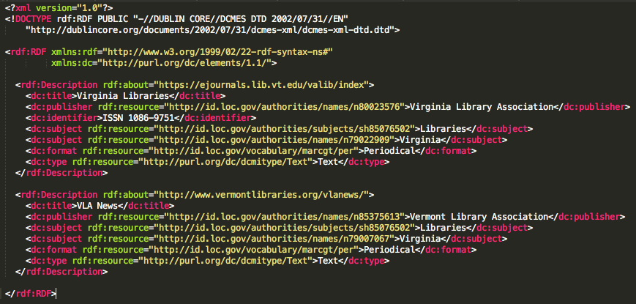
RDF-XML

Slide 53
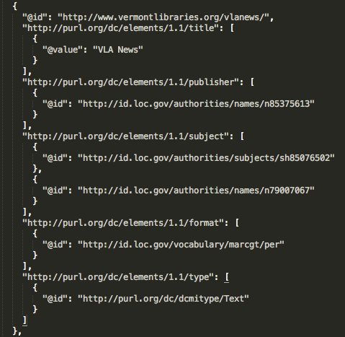
JSON-LD

Slide 54
N-Triples
<https://ejournals.lib.vt.edu/valib/index> <http://purl.org/dc/elements/1.1/title> "Virginia Libraries" .
<https://ejournals.lib.vt.edu/valib/index> <http://purl.org/dc/elements/1.1/publisher> <http://id.loc.gov/authorities/names/n80023576> .
<https://ejournals.lib.vt.edu/valib/index> <http://purl.org/dc/elements/1.1/identifier> "ISSN 1086-9751" .
<https://ejournals.lib.vt.edu/valib/index> <http://purl.org/dc/elements/1.1/subject> <http://id.loc.gov/authorities/subjects/sh85076502> .
<https://ejournals.lib.vt.edu/valib/index> <http://purl.org/dc/elements/1.1/subject> <http://id.loc.gov/authorities/names/n79022909> .
<https://ejournals.lib.vt.edu/valib/index> <http://purl.org/dc/elements/1.1/format> <http://id.loc.gov/vocabulary/marcgt/per> .
<https://ejournals.lib.vt.edu/valib/index> <http://purl.org/dc/elements/1.1/type> <http://purl.org/dc/dcmitype/Text> .

Slide 55
N3
@prefix dc11: <http://purl.org/dc/elements/1.1/> .
<https://ejournals.lib.vt.edu/valib/index>
dc11:title "Virginia Libraries" ;
dc11:publisher <http://id.loc.gov/authorities/names/n80023576> ;
dc11:identifier "ISSN 1086-9751" ;
dc11:subject <http://id.loc.gov/authorities/subjects/sh85076502>, <http://id.loc.gov/authorities/names/n79022909> ;
dc11:format <http://id.loc.gov/vocabulary/marcgt/per> ;
dc11:type <http://purl.org/dc/dcmitype/Text> .
<http://www.vermontlibraries.org/vlanews/>
dc11:title "VLA News" ;
dc11:publisher <http://id.loc.gov/authorities/names/n85375613> ;
dc11:subject <http://id.loc.gov/authorities/subjects/sh85076502>, <http://id.loc.gov/authorities/names/n79007067> ;
dc11:format <http://id.loc.gov/vocabulary/marcgt/per> ;
dc11:type <http://purl.org/dc/dcmitype/Text> .

Slide 56
Turtle
@prefix dc11: <http://purl.org/dc/elements/1.1/> .
<https://ejournals.lib.vt.edu/valib/index>
dc11:title "Virginia Libraries" ;
dc11:publisher <http://id.loc.gov/authorities/names/n80023576> ;
dc11:identifier "ISSN 1086-9751" ;
dc11:subject <http://id.loc.gov/authorities/subjects/sh85076502>, <http://id.loc.gov/authorities/names/n79022909> ;
dc11:format <http://id.loc.gov/vocabulary/marcgt/per> ;
dc11:type <http://purl.org/dc/dcmitype/Text> .
<http://www.vermontlibraries.org/vlanews/>
dc11:title "VLA News" ;
dc11:publisher <http://id.loc.gov/authorities/names/n85375613> ;
dc11:subject <http://id.loc.gov/authorities/subjects/sh85076502>, <http://id.loc.gov/authorities/names/n79007067> ;
dc11:format <http://id.loc.gov/vocabulary/marcgt/per> ;
dc11:type <http://purl.org/dc/dcmitype/Text> .

Slide 57
TURTLE!!!

Slide 58

Turtle
Language
http://vignette3.wikia.nocookie.net/tmnt/images/3/34/Cowabunga.jpg/revision/latest?cb=20130828015956

Slide 59
Simple Triples
<subject> <predicate> <object> .
<Class> <property> <Class> .
<http://www.worldcat.org/oclc/6626957> <http://id.loc.gov/ontologies/bibframe.html#subject> <http://id.loc.gov/authorities/subjects/sh85020816> .
Notes:
“The Joy of Cataloging” has subject Cataloging.

Slide 60
Predicate Lists
When you have to say more than one things about a subject.
<subject> <predicate> <object> ;
<predicate> <object> ;
<predicate> <object> .
<http://www.worldcat.org/oclc/6626957>
<http://id.loc.gov/ontologies/bibframe.html#subject> <http://id.loc.gov/authorities/subjects/sh85020816> ;
<http://id.loc.gov/ontologies/bibframe.html#subject> <http://id.loc.gov/authorities/subjects/sh85129425> ;
<http://id.loc.gov/ontologies/bibframe.html#classification> <http://id.loc.gov/authorities/classification/Z693.A3-Z693.Z> .
Notes:
Heads up - you’re going to see a lot of semicolons today.
“The Joy of Cataloging” has subjects Cataloging and Subject cataloging and classification number Z693.A3-Z693.Z.

Slide 61
Object Lists
When you have more than one object for a subject on the same predicate -- separate them with a comma
<subject> <predicate> <object>, <object> .
<some_book> bf:heldBy "DLC", "NNC" .
bf:title [ a bf:Title, bf:VariantTitle ] ;

Slide 62
URIs (aka IRIs)
URIs can be relative or absolute, or prefixed names.
Relative and absolute URIs are enclosed in angled brackets <URI>
Relative URIs like <#example> are resolved to the base URI that is declared as the @base or BASE
@base <http://library.edu/>
<#book_0912700513> = http://library.edu/#book_0912700513
Notes:
Note: I don’t think we’ll be showing them any more examples of this <#...> usage.

Slide 63
Prefixes
Prefixes allow for shorthand references to ontology domains.
@base <http://library.edu/> .
@prefix rdf: <http://www.w3.org/1999/02/22-rdf-syntax-ns#> .
@prefix rdfs: <http://www.w3.org/2000/01/rdf-schema#> .
@prefix bf: <http://id.loc.gov/ontologies/bibframe/> .
Notes:
When you see a prefix, you’re looking at a URI.

Slide 64
Prefixes Continued
@base <http://library.edu/> .
@prefix rdf: <http://www.w3.org/1999/02/22-rdf-syntax-ns#> .
@prefix rdfs: <http://www.w3.org/2000/01/rdf-schema#> .
@prefix bf: <http://id.loc.gov/ontologies/bibframe/> .
<Berman_work1>
a bf:Work ;
bf:hasInstance <Berman_inst1> ;
bf:adminMetadata <Berman_admin1> ;
bf:title [
a bf:Title, bf:WorkTitle ;
bf:mainTitle "Joy of cataloging" ;
bf:subTitle "essays, letters, and other explosions" ;
] ;
Notes:
Could we start with a very simple illustration like this?
bf:Work means/should be read as: http://id.loc.gov/ontologies/bibframe/Work

Slide 65
Prefixes Continued
@base <http://library.edu/> .
@prefix rdf: <http://www.w3.org/1999/02/22-rdf-syntax-ns#> .
@prefix rdfs: <http://www.w3.org/2000/01/rdf-schema#> .
@prefix bf: <http://id.loc.gov/ontologies/bibframe.rdf> .
<Berman_work1>
a bf:Work ;
bf:hasInstance <Berman_inst1> ;
bf:adminMetadata <Berman_admin1> ;
bf:title [
a bf:Title, bf:WorkTitle ;
bf:mainTitle "Joy of cataloging" ;
bf:subTitle "essays, letters, and other explosions" ;
] ;

Slide 66
“A” type of Thing
The token 'a' in the predicate position of a Turtle triple represents the URI http://www.w3.org/1999/02/22-rdf-syntax-ns#type.
<Berman_work1>
a bf:Work ;
bf:title [ a bf:Title, bf:VariantTitle ] .
Notes:
Add that it can also be written (once you’ve defined your namespaces) as rdf:type.

Slide 67
Literally Literals
Datatype properties require a literal value for their object. Enclose all literals with quotes -- “literal.” Literals are used to identify values such as strings, numbers, dates.
bf:supplementaryContent "Includes index." ;
bf:responsibilityStatement "by Sanford Berman" ;
bf:shelfmark "Z693 .B47 1981" .
bf:mainTitle “Joie du catalogage”@fr
Notes:
Can we insert a slide here illustrating @ and ^^ ? There will be examples of both in the mapping I show later.
From https://www.w3.org/TeamSubmission/turtle/#sec-tutorial:
Literals may be given either a language suffix or a datatype URI but not both. Languages are indicated by appending the simple literal with @ and the language tag. Datatype URIs similarly append ^^ followed by any legal URI form (full or qualified) as described above to give the datatype URI.
# this is not a complete turtle document "chat" "chat"@en "chat"@fr "foo"^^<http://example.org/my/datatype> """10"""^^xsd:decimal

Slide 68
Datatype IRI
You can specify a datatype for a literal using an IRI with a ^^ notation.
<http://bibframe.example.org/XXX#Instance
bf:provisionActivity
[ a bf:ProvisionActivity, bf:Publication ;
bf:date "2007/2010"^^<http://id.loc.gov/datatypes/edtf> ;
bf:place <http://id.loc.gov/vocabulary/countries/ko> ] .

Slide 69
Nesting Blank Nodes
Super common in BIBFRAME when you need to provide legacy literal information.
<Berman_inst1>
bf:provisionActivity
[
a bf:ProvisionActivity, bf:Publication ;
bf:agent
[
a bf:Agent ;
rdfs:label "Oryx Press"
] ;
bf:place
[
a bf:Place ;
rdfs:label "Phoenix, AZ"
] ;
bf:date "1981"
] .

Slide 70

Turtle
(Power!)
Grammar
http://vignette3.wikia.nocookie.net/fictionalcrossover/images/0/03/TMNT.jpg/revision/latest?cb=20131107221430

Slide 71
White Space
White space is largely ignored in Turtle, except for literals.
bf:summary "A collection of essays and letters on cataloging, classification, and indexing." ;
Use ''' to escape quotes within a literal.
bf:summary '''"A fantastic read!" says Maurice Freedman.''' ;

Slide 72
Comments
Add comments to your code by using the hash # sign.
@base <http://library.edu/> .
@prefix rdf: <http://www.w3.org/1999/02/22-rdf-syntax-ns#> .
@prefix rdfs: <http://www.w3.org/2000/01/rdf-schema#> .
@prefix bf: <http://id.loc.gov/ontologies/bibframe.rdf> .
#This is a test record for the PCC BIBFRAME TG
<Berman_work1>

Slide 73

Putting it all together
https://github.com/amberbilley/PCC_BIBFRAME/blob/master/BF_Berman_Example.ttl
http://vignette4.wikia.nocookie.net/tmnt/images/3/31/T_U_R_T_L_E_POWER!.jpg/revision/latest?cb=20130825150401
Notes:
Started entering a few suggested edits here and came up with more than I expected, sorry!
@prefix bf: <http://id.loc.gov/ontologies/bibframe.rdf> . - change to @prefix bf: <http://id.loc.gov/ontologies/bibframe/> .
bf:adminMetadata <Berman_admin1> ; - does it make sense for the work, instance and item all to link to the same adminMetadata? Not sure
bf:title [a bf:Title, bf:WorkTitle ; -delete bf:WorkTitle (deprecated)
bf:role "author" ; - bf:role is object property, object could be <http://id.loc.gov/vocabulary/relators/aut.html>
bf:supplementaryContent - this is an object property so if we keep these lines we’ll need blank nodes
bf:provisionActivity - revise as in my comment earlier
bf:barcode "1234567890111" ; - deprecated, replaced by bf:Barcode subclass of bf:Identifier
bf:assigner "ab3167" ; - object property, needs URI or blank node
bf:descriptionConvensions "rda" ; - also object property; typo in Conventions
bf:descriptionLanguage [ … ] - simplify to bf:descriptionLanguage <http://id.loc.gov/vocabulary/languages/eng>
bf:creationdate "2016-11-14". - maybe add suffix or whatever you call these things: bf:creationdate "2016-11-14"^^xsd:date.

Slide 74
Linked Data
Tools

Slide 75
Text Editor (your best friend)
MACS
Text Wrangler (Free and open source)
PCs
Notepad++ (Free and open source)
Either
Sublime Text (Open source, free trial, paid license)
Atom (Open source, free)

Slide 76
Data validators and Converters
W3C RDF Validator (parses and builds graphs)
https://www.w3.org/RDF/Validator/
EasyRDF Converter
http://www.easyrdf.org/converter
JSON-LD
http://json-ld.org/playground/
Turtle
http://ttl.summerofcode.be/
Or seriously...just Google it.

Slide 77
Custom Editor
Library Linked Data Projects
BIBFRAME Editor
VitroLib Editor
Cedar Editor and BiblioPortal
BIBFLOW Editor
Local development
Fedora 4
Samvera
Islandora
Library Vendors
Casalini
Ex Libris
Innovative
Folio
OCLC Worldshare Management

Slide 78
Protege
Software for ontology modeling and development.
http://protege.stanford.edu/
We already
talked about this :-)

Slide 79
Karma
An ontology modeling and visualization tool.
“A data integration tool.”
http://usc-isi-i2.github.io/karma/

Slide 80

Open Refine
A data munging, modeling, reconciling, power tool.
http://openrefine.org/

Slide 81
Text Editor Demo

Slide 82
Serials in BIBFRAME!

Slide 83
Serials RDA Elements in BIBFRAME
Mappings:
LC: MARC 21 to BIBFRAME 2.0 Conversion Specifications https://www.loc.gov/bibframe/mtbf/
CONSER: BIBFRAME 2.0 CSR Mapping (coming soon; watch this space: http://www.loc.gov/aba/pcc/conser/index.html)
Notes:
We’ll be presenting RDA encoded in BF 2.0 based on the mapping LC is using in conversion and supplemented by ideas from the forthcoming CONSER mapping.
The published LC mapping is from MARC, the CONSER mapping will be from RDA, so they don’t always answer the same questions.
Keep in mind that we see in conversion doesn’t necessarily reflect what we’ll be doing in the future for original linked data creation, but it’s what we have to look at for now.

Slide 84
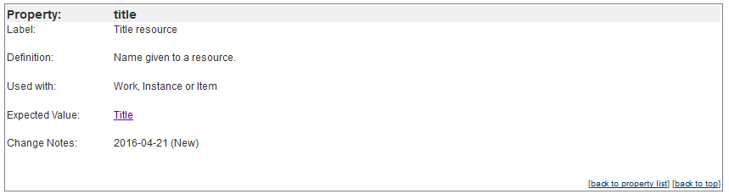
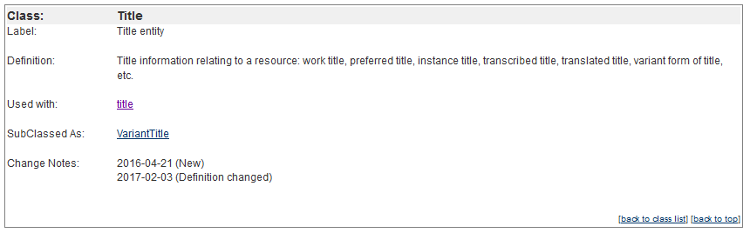
BIBFRAME 2.0 ontology
http://id.loc.gov/ontologies/bibframe.html
Notes:
Reminder: the ontology tells us how we can use these terms (classes and properties).
They’re used to form triples: Subject (Class) > predicate (property) > Object (Class or Literal)
Properties: The ontology tells us what they can be “used with” (what they can have as a subject), what their “expected value” is (what they can have as an object; either a class or a literal), and what subproperties they have, if any (none here).
Classes: The ontology tells us what they can be “used with” (what they can be the object of) and what subclasses they have, if any.
In the examples that follow, classes will appear as either 1. a URI or 2. a blank node with that class as its type.

Slide 85
Instances
<http://bibframe.example.org/15297773#Instance>
a bf:Instance
Notes:
All (or almost all) examples are from the “MARC to BIBFRAME comparison viewer.” URIs like <http://bibframe.example.org/15297773#Instance> reflect its conventions, so ignore the # additions at the end; in a live environment these would be “real” URIs.
In LC’s conversion, <http://bibframe.example.org/15297773#Instance> means “instance derived from LC’s MARC bib. record no. 15297773.” (If you want to see the full data these examples are extracted from, enter the bib. number in the comparison viewer.)
Spacing or line breaks have sometimes been adjusted from the comparison viewer display to try to make things clearer.
a = rdf:type “used to state that a resource is an instance of a class”
Reminder: bf:Instance means http://id.loc.gov/ontologies/bibframe/Instance (the URI for this class).
I’m not adding any final punctuation to the examples because that depends on context (what follows, if anything).

Slide 86
Title (for display)
<http://bibframe.example.org/15297773#Instance>
bf:title
[ a bf:Title ;
rdfs:label "The international journal of Korean art and archaeology." ]
Notes:
Starting with RDA Chapter 2.
The basic mapping being illustrated is indicated by property/properties in red (sometimes also by an object subclass in red). Also remember to keep an eye on whether the property is being used with Work, Instance or Item.
This is the title as you would want to display it.
There’s no “authority file” of instance (manifestation) titles to link out to, so we’ll be grouping the information we want to record about this title into a blank node “package” here with type bf:Title. This blank node says it is a title and can be displayed as "The international journal of Korean art and archaeology."
rdfs:label is an RDF property used for “a human-readable version of a resource's name” (some of the most common properties used in BIBFRAME will be rdf: or rdfs: rather than bf:)
Reminder: the ; means the subject of the triple is repeated. The literal is inside “ ”

Slide 87
Title (for sorting)
<http://bibframe.example.org/15297773#Instance>
bf:title
[ a bf:Title ;
rdfs:label "The international journal of Korean art and archaeology." ; bflc:titleSortKey "international journal of Korean art and archaeology." ]
Notes:
This is the title as you would want to index it (beginning with I not T). The fact that LC is using bflc: suggests that this is a temporary solution?

Slide 88
Title proper
<http://bibframe.example.org/15297773#Instance>
bf:title
[ a bf:Title ;
rdfs:label "The international journal of Korean art and archaeology." ; bflc:titleSortKey "international journal of Korean art and archaeology." ;
bf:mainTitle "The international journal of Korean art and archaeology" ]
Notes:
This is how you identify the title proper. As with most serials in current cataloging, in this case the title proper is the whole title (since we usually ignore subtitles).

Slide 89
Title proper (part number, name)
<http://bibframe.example.org/11315714#Instance>
bf:title
[ a bf:Title ;
rdfs:label "Philosophical transactions of the Royal Society of London. Series A, Containing papers of a mathematical or physical character." ;
bf:mainTitle "Philosophical transactions of the Royal Society of London" ;
bf:partName "Containing papers of a mathematical or physical character" ;
bf:partNumber "Series A" ]
Notes:
Here the title proper includes a part number and name. These are encoded separately in BIBFRAME. The label shows how you want them to display (in this order, with punctuation).
(Omitted bf:titleSortKey here to save space)

Slide 90
Title proper and subtitle
<http://bibframe.example.org/12382624#Instance>
bf:title
[ a bf:Title ; rdfs:label "Gastronomica : the journal of food and culture." ; bflc:titleSortKey "Gastronomica : the journal of food and culture." ; bf:mainTitle "Gastronomica" ; bf:subtitle "the journal of food and culture" ]
Notes:
bf:subtitle = “other title information” in RDA
Here’s a record where the serials cataloger has transcribed a subtitle.

Slide 91
Variant title
<http://bibframe.example.org/15297773#Instance>
bf:title
[ a bf:Title, bf:VariantTitle ; rdfs:label "Korean art and archaeology" ; bflc:titleSortKey "Korean art and archaeology" ; bf:mainTitle "Korean art and archaeology" ]
Notes:
The , means two triples that differ only in their object.
The blank node has both types because bf:VariantTitle is a subclass of bf:Title; but bf:Title could be omitted.
Variant titles can have all the same properties as titles, including part number, name, subtitle.
This can also be used for minor title changes, with bf:date added.

Slide 92
Parallel title
<http://bibframe.example.org/11273268#Instance>
bf:title [ a bf:ParallelTitle, bf:Title, bf:VariantTitle ; rdfs:label "Korea today" ; bflc:titleSortKey "Korea today" ;
bf:mainTitle "Korea today" ]
Notes:
bf:ParallelTitle is a subclass of bf:VariantTitle which is a subclass of bf:Title; the order doesn’t matter (here they’re ordered alphabetically).

Slide 93
Abbreviated title
<http://bibframe.example.org/18270882#Instance>
bf:title [ a bf:AbbreviatedTitle, bf:Title, bf:VariantTitle ; rdfs:label "Physician leadersh. j." ; bflc:titleSortKey "Physician leadersh. j." ; bf:mainTitle "Physician leadersh. j." ; bf:source [ a bf:Source ; rdf:value "issnkey" ] ]
Notes:
The source of this abbreviated title is identified by a blank node with a value: it indicates that this is an ISSN abbreviated key title (converted from 210 2nd indicator blank).
In practice we’re only likely to have bf:mainTitle here but nothing in BIBFRAME would prevent an abbreviated title from including a subtitle.
You’ll see rdf:value used for “structured values” i.e. literals that have some sort of meaning that a computer might be able to work with: standard numbers, controlled vocabulary terms.

Slide 94
Key title
<http://bibframe.example.org/18270882#Instance>
bf:title [ a bf:KeyTitle, bf:Title, bf:VariantTitle ; rdfs:label "Physician leadership journal" ; bflc:titleSortKey "Physician leadership journal" ; bf:mainTitle "Physician leadership journal" ]
Notes:
Key titles are from the ISSN network by definition so no source is specified.

Slide 95
Statement of responsibility
<http://bibframe.example.org/17610810#Instance>
bf:responsibilityStatement "edited by Nigel G. Foster, FRSA"
Notes:
We don’t use this much in current serials cataloging, but here is how it would look.
An actionable link to the creator/contributor would be added separately (coming up later).

Slide 96
Edition statement
<http://bibframe.example.org/8330771#Instance>
bf:editionStatement "Indiana ed."
Notes:
There’s also bf:editionEnumeration (expected value: Literal) but it’s not being used in conversion; not clear how we might use it in the future.
The edition statement will also include the edition statement of responsibility, if any.
(I restored the period incorrectly deleted by conversion)

Slide 97
Numbering of serials (formatted)
<http://bibframe.example.org/11315714#Instance>
bf:firstIssue "Vol. 187 (1896)" ;
bf:lastIssue "v. 233"
Notes:
This is what you’ll use if you’re following RDA as written and recording all four of these separately (362 0_):
Numeric and/or Alphabetic Designation of First Issue or Part of Sequence,
Chronological Designation of First Issue or Part of Sequence,
Numeric and/or Alphabetic Designation of Last Issue or Part of Sequence,
Chronological Designation of Last Issue or Part of Sequence.
Enumeration and chronology are combined in one literal string for each; CONSER wants to explore a more granular way of handling this information.
Here Vol. and v. may be abbreviations of what actually appears on the piece, reflecting older cataloging conventions. Today we would transcribe what we see.

Slide 98
Numbering of serials (note)
<http://bibframe.example.org/15297773#Instance>
bf:note
[ a bf:Note ; rdfs:label "Began with v. 01 (2007); ceased with v. 04 (2010)." ; bf:noteType "Numbering" ]
Notes:
This is current CONSER practice: recording all this in a more or less standardized note (362 1_). If more sophisticated ways of recording this information become available in BIBFRAME we may well reconsider our practice.
Another blank node. This is a preview of how notes are coded; we’ll see more later.

Slide 99
Publication statement (transcribed)
<http://bibframe.example.org/15297773#Instance>
bf:provisionActivityStatement "Seoul : National Museum of Korea, 2007-©2010."
Notes:
Transcribed from the piece and recorded as one long literal with ISBD punctuation.
You could also use this property once or multiple times for production, distribution, manufacture (but these subtypes can’t be distinguished from each other).
For “minimal” linked data cataloging, you might stop here. But…

Slide 100
Publication statement (segmented)
<http://bibframe.example.org/15297773#Instance>
bf:provisionActivity [ a bf:ProvisionActivity, bf:Publication ; bf:agent [ a bf:Agent ; rdfs:label "National Museum of Korea" ] ; bf:date "2007-©2010" ; bf:place [ a bf:Place ; rdfs:label "Seoul" ] ]
Notes:
Here we’re using blank nodes with labels (within a larger blank node for the provision activity as a whole) to identify the different parts of the transcribed statement. The parts still aren’t linked to anything.
In the future we might replace or supplement these with actual URIs for the publisher and place of publication and actionable dates (see next slide).
You could replace bf:Publication with bf:Production, bf:Distribution, bf:Manufacture and record any or all as appropriate.
Multiple publishers over time: $3 is being converted to bflc:appliesTo [rdfs:label “2000?-2002” ]; this is probably not the model for the future.

Slide 101
Publication information (using URIs)
<http://bibframe.example.org/15297773#Instance
bf:provisionActivity [ a bf:ProvisionActivity, bf:Publication ; bf:date "2007/2010"^^<http://id.loc.gov/datatypes/edtf> ; bf:place <http://id.loc.gov/vocabulary/countries/ko> ]
Notes:
Additional data from conversion that gives a preview of how more machine-actionable publication data might work in the future. The dates are from the 008 date fields and the place is from the MARC 008 country code. But in original linked data we could link to specific cities etc.
Identifying the dates this way as EDFT (or another format) will make them machine-actionable.
Date type link is to “Extended Date/Time Format Datatypes Scheme” at LC’s Linked Data Service.
Place link is to Korea (South) at MARC List of Countries.

Slide 102
Copyright date
<http://bibframe.example.org/19276940#Instance> bf:copyrightDate "©2015"
Notes:
This is just a transcribed date with the copyright symbol included. If you also recorded it in a standard format (like the example with ^^<http://id.loc.gov/datatypes/edtf> in the previous slide) that would be machine-actionable.

Slide 103
Series statement
<http://bibframe.example.org/17610810#Instance>
bf:seriesStatement "Blackstone's statutes series"
Notes:
This is transcribed. The actual link to the larger series work will be handled later as a relationship.
If the series applies just to part of the publication, $3 is being converted to bflc:appliesTo [rdfs:label “1972/73-1975-76” ]; not a permanent solution?

Slide 104
Series statement and enumeration
<http://bibframe.example.org/317269#Instance>
bf:seriesEnumeration "65, v. 5", "v. 5" ;
bf:seriesStatement "Archetypal images in Greek religion", "Bollingen series"
Notes:
A problem with BIBFRAME at the moment: there is currently no way to link the right enumeration to the right statement; this is actually Bollingen series 65, v. 5 and Archetypal images in Greek religion v.5.

Slide 105
Mode of issuance
<http://bibframe.example.org/15297773#Instance>
bf:issuance <http://id.loc.gov/vocabulary/issuance/serl>
Notes:
This will be the same for all serials.
Link is to a “MARC Issuance Collection” term at LC’s Linked Data Service.
(Also: 008 fixed field p for periodical is converting to <http://bibframe.example.org/15297773#Instance> bf:genreForm <http://id.loc.gov/vocabulary/marcgt/per> )

Slide 106
Frequency
<http://bibframe.example.org/15297773#Instance>
bf:frequency
[ a bf:Frequency ; rdfs:label "Annual" ]
Notes:
Just a blank node with a text label here. But see next slide.
$b is being converted to bf:date

Slide 107
Frequency
<http://bibframe.example.org/15297773#Instance>
bf:frequency
[ a bf:Frequency ; rdfs:label "Annual" ], <http://id.loc.gov/vocabulary/frequencies/ann>
Notes:
The URI for annual is being converted from the 008 Freq field.
Link is to List of Publication Frequencies at LC’s Linked Data Service.
The 008 Regl field is converted to an additional Frequency label:
<http://bibframe.example.org/15297773#Instance>
bf:frequency
[ a bf:Frequency ;
rdfs:label "regular" ]

Slide 108
ISSN
<http://bibframe.example.org/15297773#Instance>
bf:identifiedBy [ a bf:Identifier, bf:Issn ; rdf:value "2005-1115" ]
Notes:
bf:Issn is a subclass of bf:Identifier, though the larger class isn’t being included in LC’s conversion.
Sometimes you’ll also see a “source” included for the ISSN (corresponding to 022 $2)
No URIs available for ISSNs yet, so this is another blank node with a value. But maybe someday we would link to this ISSN at the ISSN International Centre?

Slide 109
LCCN
<http://bibframe.example.org/15297773#Instance>
bf:identifiedBy [ a bf:Identifier, bf:Lccn ; rdf:value " 2008200843" ]
Notes:
bf:Lccn is a subclass of bf:Identifier, though the larger class isn’t being included in LC’s conversion.
The literal includes the two initial spaces.

Slide 110
DBO/LIC notes
<http://bibframe.example.org/15297773#Instance>
bf:note
[ a bf:Note ; rdfs:label "Description based on: Vol. 01 (2007); title from t.p." ; bf:noteType "description source" ], [ a bf:Note ; rdfs:label "Latest issue consulted: Vol. 04 (2010)." ; bf:noteType "description source" ]
Notes:
CONSER has discussed establishing these issues as separate works (parts) and then linking to them, rather than just entering text notes like this.

Slide 111
More notes
<http://bibframe.example.org/11315714#Instance>
bf:note
[ a bf:Note ;
rdfs:label "Vols. for 1901-1930. 1 v.; 1931-1940. 1 v. (includes issues published under later title)." ;
bf:noteType "index" ]
Notes:
In this case, an index note. Other note types seen in conversion include “bibliography,” “issuance information” (for numbering peculiarities), “issuing body,” etc.

Slide 112
Media
<http://bibframe.example.org/15297773#Instance>
bf:media <http://id.loc.gov/vocabulary/mediaTypes/n>
Notes:
Moving into RDA Chapter 3 now.
Link corrected from mediaType to mediaTypes. Link is for “unmediated” in Media Types at LC Linked Data Service.
For online resource, would be <http://id.loc.gov/vocabulary/mediaTypes/c> (computer)

Slide 113
Carrier
<http://bibframe.example.org/15297773#Instance>
bf:carrier <http://id.loc.gov/vocabulary/carriers/nc>
Notes:
Link is to “volume” in “Carriers Scheme” at LC’s Linked Data Service.
For online resource, would be <http://id.loc.gov/vocabulary/carriers/cr> (online resource)

Slide 114
Extent
<http://bibframe.example.org/15297773#Instance>
bf:extent
[ a bf:Extent ; rdfs:label "4 volumes" ]
Notes:
Just a blank node with a text label.
But in original linked data we could be more granular using bf:unit:
bf:extent
[a bf:Extent ;
rdf:value “4” ;
bf:unit
[a bf:Unit ;
rdfs:label “volumes” ] ]

Slide 115
Illustrations?
<http://bibframe.example.org/15297773#Instance>
bf:note
[ a bf:Note ; rdfs:label "illustrations" ; bf:noteType "Physical details" ]
[but see http://id.loc.gov/ontologies/bibframe.html#p_illustrativeContent]
Notes:
Illustrative Content is expression-level in RDA, but 300 $b is being converted as a “Physical details” note on the manifestation/instance. Presumably because it’s not safe to make assumptions about expression-level content from our current MARC records.

Slide 116
Dimensions
<http://bibframe.example.org/15297773#Instance>
bf:dimensions "30 cm"
Notes:
Again, just a text label. Some in CONSER, LD4P and elsewhere would like to make this information more granular and actionable: number, unit, etc.

Slide 117
URL
<http://bibframe.example.org/item/item5>
bf:electronicLocator "http://hdl.loc.gov/loc.pnp/cph.3g11323"
Notes:
Example is from BIBFRAME Item Proposal, June 24 2015. Link is to an image in LC’s Prints and Photographs Online Catalog (PPOC).

Slide 118
Relationships (Instances)
<http://bibframe.example.org/15297773#Instance>
bf:otherPhysicalFormat <http://bibframe.example.org/15297773#Instance776-41> .
<http://bibframe.example.org/15297773#Instance>
bf:instanceOf <http://bibframe.example.org/15297773#Work> .
<http://bibframe.example.org/15297773#Instance>
bf:hasItem <http://bibframe.example.org/15297773#Item050-13>
Notes:
Links among instances (i.e. manifestations), up to the work and down to the item.

Slide 119
Works
<http://bibframe.example.org/15297773#Work>
a bf:Text, bf:Work
Notes:
RDA Chapter 6.
bf:Text is a subclass of bf:Work; others are bf:Audio, bf:StillImage, bf:MovingImage etc.

Slide 120
Work title
<http://bibframe.example.org/15297773#Work>
bf:title
[ a bf:Title ; rdfs:label "The international journal of Korean art and archaeology." ; bflc:titleSortKey "international journal of Korean art and archaeology." ; bf:mainTitle "The international journal of Korean art and archaeology" ]
Notes:
Same as instance title. In RDA cataloging, works won’t have subtitles.
If the AAP for the work includes qualifiers, those are also included in these literals (label, titleSortKey, mainTitle). No distinction is currently made in BIBFRAME encoding between the preferred title of the work and the AAP for the work.

Slide 121
ISSN-L
<http://bibframe.example.org/11273268#Work>
bf:identifiedBy
[ a bf:Identifier, bf:IssnL ;
rdf:value "1227-1632" ]
Notes:
But there are questions about whether this mapping is appropriate; ISSN-L sometimes corresponds to work and sometimes to expression.

Slide 122
Content
<http://bibframe.example.org/15297773#Work>
bf:content
<http://id.loc.gov/vocabulary/contentTypes/txt>
Notes:
RDA Chapter 7
Link corrected from contentType to contentTypes. Link is for “text” in Content Types in LC Linked Data Service.

Slide 123
Language of expression
<http://bibframe.example.org/15297773#Work>
bf:language
<http://id.loc.gov/vocabulary/languages/eng>
Notes:
In BIBFRAME, each language expression will be a different BIBFRAME work.
Link is to the MARC List of Languages.
For more complicated language information, we would use a note.

Slide 124
Contributor
<http://bibframe.example.org/15297773#Work>
bf:contribution
[ a bf:Contribution ; bf:agent <http://id.loc.gov/authorities/names/n81039362> ; bf:role <http://id.loc.gov/vocabulary/relators/ctb> ]
Notes:
Contribution information is gathered together in a blank node.
Name link is to the LC Name Authority File. This is the National Museum of Korea.
Role link is to the MARC List of Relator Terms. This is just a “contributor” (converted from a 710) but you could have author (aut), issuing body (isb), jurisdiction governed (jug), etc.
(This same pattern can be used for instance-level contributors as well.)

Slide 125
Subject
<http://bibframe.example.org/15297773#Work>
bf:subject <http://bibframe.example.org/15297773#Topic650-28>, <http://bibframe.example.org/15297773#Topic650-30>, <http://bibframe.example.org/15297773#Topic650-31>
Notes:
In real life URIs would be for subjects published online as linked data. (Basic LCSH has been published as linked data, but MARC records contain complex LCSH strings that don’t have URIs.)
Converter also has 043 converted as:
<http://bibframe.example.org/15297773#Work>
bf:geographicCoverage
<http://id.loc.gov/vocabulary/geographicAreas/a-kr>

Slide 126
Classification (work)
<http://bibframe.example.org/15297773#Work>
bf:classification
[ a bf:ClassificationLcc ;
bf:classificationPortion "N8.K6" ;
bf:itemPortion "I58" ;
bf:source <http://id.loc.gov/vocabulary/organizations/dlc> ]

Slide 127
Classification (item)
<http://bibframe.example.org/15297773#Item050-13>
bf:shelfMark
[ a bf:ShelfMarkLcc ;
rdfs:label "N8.K6 I58" ;
bf:source <http://id.loc.gov/vocabulary/organizations/dlc> ]

Slide 128
Genre/Form
<http://bibframe.example.org/15297773#Work>
bf:genreForm <http://bibframe.example.org/15297773#GenreForm655-38>
Notes:
In real life URIs would be for genres/forms published online as linked data.

Slide 129
Relationships (Works)
<http://bibframe.example.org/15297773#Work>
bf:hasInstance <http://bibframe.example.org/15297773#Instance>, <http://bibframe.example.org/15297773#Instance530-25> .
<http://bibframe.example.org/17610810#Work>
bf:continues <http://bibframe.example.org/17610810#Work780-31> .
<http://bibframe.example.org/15297773#Work>
bf:continuedBy <http://bibframe.example.org/15297773#Work785-42> .
<http://bibframe.example.org/17610810#Work
bf:hasSeries <http://bibframe.example.org/17610810#Work830-32>
Notes:
Relationships between work and instance, among works (continued/continued by, series).

Slide 130
Non-Roman script
<http://bibframe.example.org/19583382#Instance>
bf:provisionActivityStatement
"Beijing Shi : Jie fang jun wen yi chu ban she",
"北京市 : 解放军文艺出版社"@zh-hani ;
bf:title
[ a bf:Title ;
rdfs:label "中国军事文学年选."@zh-hani ;
bf:mainTitle "中国军事文学年选"@zh-hani ],
[ a bf:Title ;
rdfs:label "Zhongguo jun shi wen xue nian xuan." ;
bf:mainTitle "Zhongguo jun shi wen xue nian xuan" ]
Notes:
And finally, multiple scripts. The property and literal are just repeated, with a script code appended to the non-Roman literals. [But not always? In conversion there is no @ at the end of the Arabic-script literals.]
zh-hani means “Chinese language in CJK script.”
If you had e.g. multiple variant titles, I’m not sure you would be able to link each non-Roman directly to its romanized version?

Slide 131
Testing and Experimentation

Slide 132
Library of Congress
BIBFRAME Pilot Phase One (August 2015 - March 2016)
“Forty Library of Congress catalogers participated in Pilot Phase One, with instruction by four Library of Congress staff members in the Cooperative and Instructional Programs Division (COIN). Pilot Phase One tested bibliographic description in multiple formats and in multiple languages using the BIBFRAME Editor.”
https://www.loc.gov/catworkshop/bibframe/
Notes:
Catalogers created records in both BIBFRAME and MARC; starting in December, they started creating the BIBFRAME first. The learned they needed to have a good knowledge of RDA to be able to do their work without relying on the “crutch” of MARC tagging.

Slide 133
Library of Congress
BIBFRAME Pilot Phase Two (June 2017 - )
“The forty Library of Congress catalogers that participated in Pilot Phase One were joined by twenty-three new participants for Pilot Phase Two. Pilot Phase Two continues the tests from Phase One, with additional testing of the input of non-Latin scripts for description with no corresponding romanization, testing of authority descriptions for Agents, and a fuller level of interaction with a live BIBFRAME database, consisting of a complete BIBFRAME conversion of the Library of Congress bibliographic file.”
https://www.loc.gov/catworkshop/bibframe/
Notes:
The big difference here is that catalogers are working in a live database of converted data, giving a more realistic context to their work.

Slide 134
CONSER
CONSER Bibframe Task Group formed December 2015
became subgroup of the PCC BIBFRAME Task Group August 2016
submitted mapping, report and recommendations July 2017

Slide 135
CONSER
CSR to BIBFRAME Mapping:
http://www.loc.gov/aba/pcc/bibframe/TaskGroups/CSR-PDF/CSRtoBIBFRAMEMapping.pdf
Mapping across:
RDA instructions & elements
RDA-RDF property
BF 2.0 property
Includes links to sample code documents illustrating the use of the properties listed
Notes:
The CONSER mapping is mostly identical to the mapping already used by LC. There are some differences in how it recommends note types be labeled, and it includes the option of using a more specific external property rather than bf:contribution.

Slide 136
CONSER
Final Report of the CONSER CSR to BIBFRAME Mapping Task Group:
http://www.loc.gov/aba/pcc/bibframe/TaskGroups/CSR-PDF/FinalReportCONSERToPCCBIBFRAMETaskGroup.pdf
BIBFRAME can accommodate the information required to describe serial resources
BIBFRAME offers greater potential for exposing the relationships between and among serial publications than the MARC environment
but there are some general issues to address

Slide 137
CONSER
Changes to the Description
the serial itself has changed
new information about the serial is available
errors need to be corrected
Notes:
BIBFRAME is not very good at handling much of this. For the first case, it would be helpful if we could separately identify starting and ending dates to associate with changes in e.g. frequency. For the second and third, it wasn’t clear how we would deprecate existing triples and replace them with new ones. In discussion after the report was submitted the CONSER was assured that there are ways to handle this in general linked data practice, but the details haven’t been spelled out yet.

Slide 138
CONSER
Literal vs. Machine-Actionable Data
bf:provisionActivity [ a bf:ProvisionActivity, bf:Publication ; bf:agent [ a bf:Agent ; rdfs:label "National Museum of Korea" ] ; bf:place [ a bf:Place ; rdfs:label "Seoul" ] ]
bf:provisionActivity [ a bf:ProvisionActivity, bf:Publication ; bf:agent <http://id.loc.gov/authorities/names/n81052631.html> ; bf:place <http://id.loc.gov/authorities/names/n79066627.html>
Notes:
The current modeling uses a lot of literal text strings, largely because it’s been developed to handle all the data we’re going to have to convert. And exact transcription of data is still important for many types of cataloging. But we could do so much more with the same information entered in machine-actionable format. Will we have to accommodate both approaches indefinitely?

Slide 139
CONSER
Enumeration and Chronology
bf:firstIssue "Vol. 187 (1896)" ;
bf:lastIssue "v. 233"
RDA:
Numeric and/or Alphabetic Designation of First Issue or Part of Sequence
Chronological Designation of First Issue or Part of Sequence
Numeric and/or Alphabetic Designation of Last Issue or Part of Sequence
Chronological Designation of Last Issue or Part of Sequence
Notes:
Could this information be broken down in a more granular way, recording the RDA elements? Or could the issues themselves have separate URIs to link to for multiple purposes (identifying first and last issues, DBO and LIC notes, other issue-specific information)?

Slide 140
CONSER
Modeling and Relationships
FRBR: 4 levels
BIBFRAME: 3 levels
LRM: for serials: the WEM lock!
Notes:
FRBR and RDA define four levels, and BIBFRAME only three. For serials, LRM with have only two: W/E/M and Item. There’s a sense among serials catalogers that these models have been developed primarily with monographs in mind, and fitting serials into them has been a challenge and doesn’t always seem to get us much. Is this a problem, or just something we can work around?

Slide 141
CONSER
Administrative Metadata
Description Based On/Latest Issue Consulted
provenance for the “record” or individual assertions?
Notes:
Will the DBO/LIC notes still be meaningful if there is no defined “record” in a future environment of linked data assertions? Will there be a “wrapper” to tie together groups of assertions equivalent or our current records? Or is it realistic to expect that we will develop a way of indicating the provenance of individual assertions instead?

Slide 142
CONSER
Specific Issues
use value vocabularies from the RDA Registry
provide actionable links for publication etc.
use specific note properties whenever possible
series!

Slide 143
CONSER
Recommendations for CONSER/PCC
1. explore methods of accommodating the need to change serial descriptive data
2. use typed literals for dates wherever possible
3. provide actionable data whenever feasible in addition to transcribed data
4. develop a common structure for representing enumeration and chronology information

Slide 144
CONSER
Recommendations for CONSER/PCC (continued)
5. explore PRESSoo and other linked data vocabularies for possible solutions
6. charge a Task Group with monitoring and analyzing the changing serials landscape
7. develop methods and best practices for easily and succinctly recording necessary administrative and provenance metadata at the assertion level
8. use the value vocabularies from the RDA registry for Content, Media, and Carrier Types; Frequency; and Notes

Slide 145
CONSER
Recommendations for BIBFRAME Development
1. explicitly model start and end dates for descriptive elements
2. develop a common structure for representing enumeration and chronology information
3. develop methods and best practices for easily and succinctly recording necessary administrative and provenance metadata at the assertion levelel.
4. define properties for the RDA relationships 'augmented by (work)' or 'complemented by (work)'

Slide 146
LD4P
Columbia, Cornell, Harvard, Library of Congress, Princeton, Stanford
https://wiki.duraspace.org/pages/viewpage.action?pageId=74515029
developing standards, guidelines, and infrastructure to communally produce metadata as linked open data
developing end-to-end workflows to create linked data in a technical services production environment
extending the BIBFRAME ontology to describe library resources in specialized domains and formats
engaging the broader library community to ensure a sustainable and extensible environment

Slide 147
LD4P
Cross-domain ontology: bibliotek-o (https://bibliotek-o.org/)
Domain-specific ontologies:
art
cartographic and geospatial
moving images
performed music
rare materials
but not serials!

Slide 148
Questions?
You’ve got to have some.

